Slide 1
Propagation Graph Neural Networks lecture-14 Course on Graph Neural Networks (Winter Term 20/21)
Christian Medeiros Adriano (christian.adriano@hpi.de) - “Chris”
Sona Ghahremani (sona.ghahremani@hpi.de )
Prof. Dr. Holger Giese (holger.giese@hpi.de)

Slide 2
Quick recap – Where are we now?
Intro and Course Organization
Graph Metrics and Random Models
Graph Structural Features – Clustering
Message Passing & Belief Propagation
Graph Embeddings - Message Passing
PageRank & Markov Chains
Graph Convolutional Networks
Graph Attention Networks
Graph Evolution Networks
Temporal Graph Networks
Graph Neural Differential Equations
Deep Graph Generative Models
Causal Graph Neural Networks
Propagation Graph Neural Networks
Network Effects, Cascading and Contagion
Outbreak Detection and Influence Maximization
Design concerns
Understand a phenomenon
Extract features
Stablish baselines
Preprocessing data
Description models
Predict an outcome
ML architecture and pipeline
Training models
Evaluation models
Prediction models
Effects of interventions
Risks of confounding
Causal structure
Intervention models

Slide 3
Topics (to be done)
Network Cascades Phenomena
Decision-Based Models (Technology adoption)
Probabilistic Models (Contagion)
Greedy and Sketch approaches
Influence maximization and Submodularity
Outbreak detection and intervention
Minimize time to detection and
Minimize the number of affected nodes
Maximize the number of detected outbreaks
Outlook
Feedback-Control of Dynamical Network Systems
Identifiability, Observability, Stability, Sensitivity
Methods for High Scale Network Systems
Scalability, Sparsity, Reliability
Quantum Programming with Applications to Machine Learning
Notes:
Dimensionality reduction (Control Theory, Dimensionality Reduction, Latent-Variable Models)
Discrete Optimization, Randomization, Exploration/Exploitation, Immutable Architectures, Microservices

Slide 4
Information Cascade Phenomenon
Definition: Information cascade consists of a set of sequential decisions that are correlated. Originally studied in behavioral economics and network theory.
“When individuals in a social network make decisions that depend on what others have done earlier, there is the potential for a cascade to form — a run of behaviors that are highly correlate” [Chierichetti, Kleinberg, Panconesi 2003]
Information cascade versus Herd behavior [Çelen & Kariv 2004]
Informational cascade: individuals ignore their private information to make a decision
Herd behavior: individuals make an identical decision, but not necessarily ignoring their private information
1
2
3
t₁
t₂
t₃
t_{i+1} = t_{i}+Δ
Empirically identifying a cascade phenomenon from a sequence of events is not obvious. Discrete time steps is one possible rule.
Chierichetti, F., Kleinberg, J., & Panconesi, A. (2014). How to schedule a cascade in an arbitrary graph. SIAM Journal on Computing, 43(6), 1906-1920.
Notes:
[Kempel, Kleinberg & Tardos 2003] In an arbitrary network,the outcome of such a cascade can depend sensitively on the order in which nodes make their decisions, butto do date there has been very little investigation of how this dependence works, or how to choose an orderto optimize various parameters of the cascade
[Çelen & Kariv 2004] Çelen, B., & Kariv, S. (2004). Distinguishing informational cascades from herd behavior in the laboratory. American Economic Review, 94(3), 484-498.
Dobson, Ian, et al. "Complex systems analysis of series of blackouts: Cascading failure, critical points, and self-organization." Chaos: An Interdisciplinary Journal of Nonlinear Science 17.2 (2007): 026103.
Kinney, R., Crucitti, P., Albert, R., & Latora, V. (2005). Modeling cascading failures in the North American power grid. The European Physical Journal B-Condensed Matter and Complex Systems, 46(1), 101-107.

Slide 5
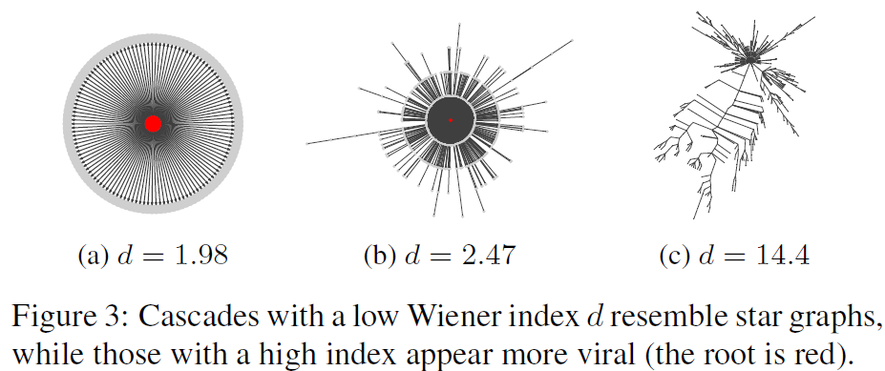
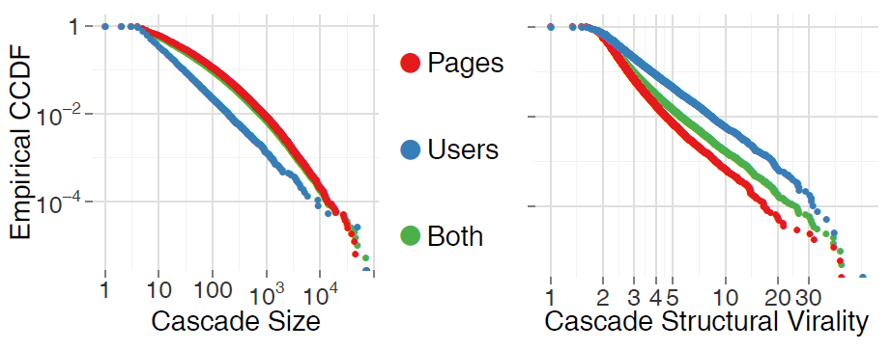
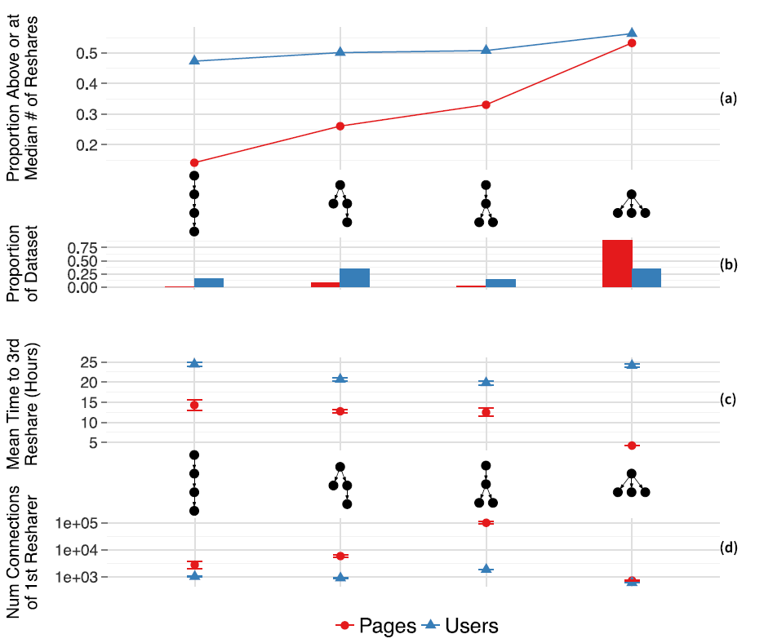
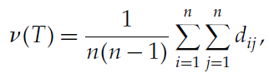
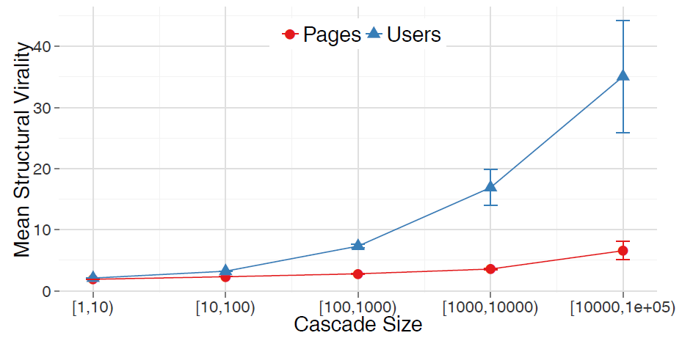
Cascade size (nodes) and virality (Wiener index)
Wiener index (or structural virality) v(T) is the average distance between all pairs of nodes in a diffusion tree T ; that is, for n>1 nodes,
Figure 2: The complementary cumulative distribution (CCDF) of cascade size (left) and structural virality measured by using the Wiener index (right).
length of the shortest path
Figure 9: Shallow initial cascade structures are indicative of larger cascades
Figure 8: The mean structural virality (Wiener index) increases with cascade size, but it is significantly higher for user cascades.
Sources: [Cheng et al 2014] [Goel et al. 2016]
Notes:
Cheng, J., Adamic, L., Dow, P. A., Kleinberg, J. M., & Leskovec, J. (2014, April). Can cascades be predicted?. In Proceedings of the 23rd international conference on World wide web (pp. 925-936).
Goel, S., Anderson, A., Hofman, J., & Watts, D. J. (2016). The structural virality of online diffusion. Management Science, 62(1), 180-196.
Wiener H (1947) Structural determination of paraffin boiling points.
J. Amer. Chemical Soc. 69(1):17–20.

Slide 6

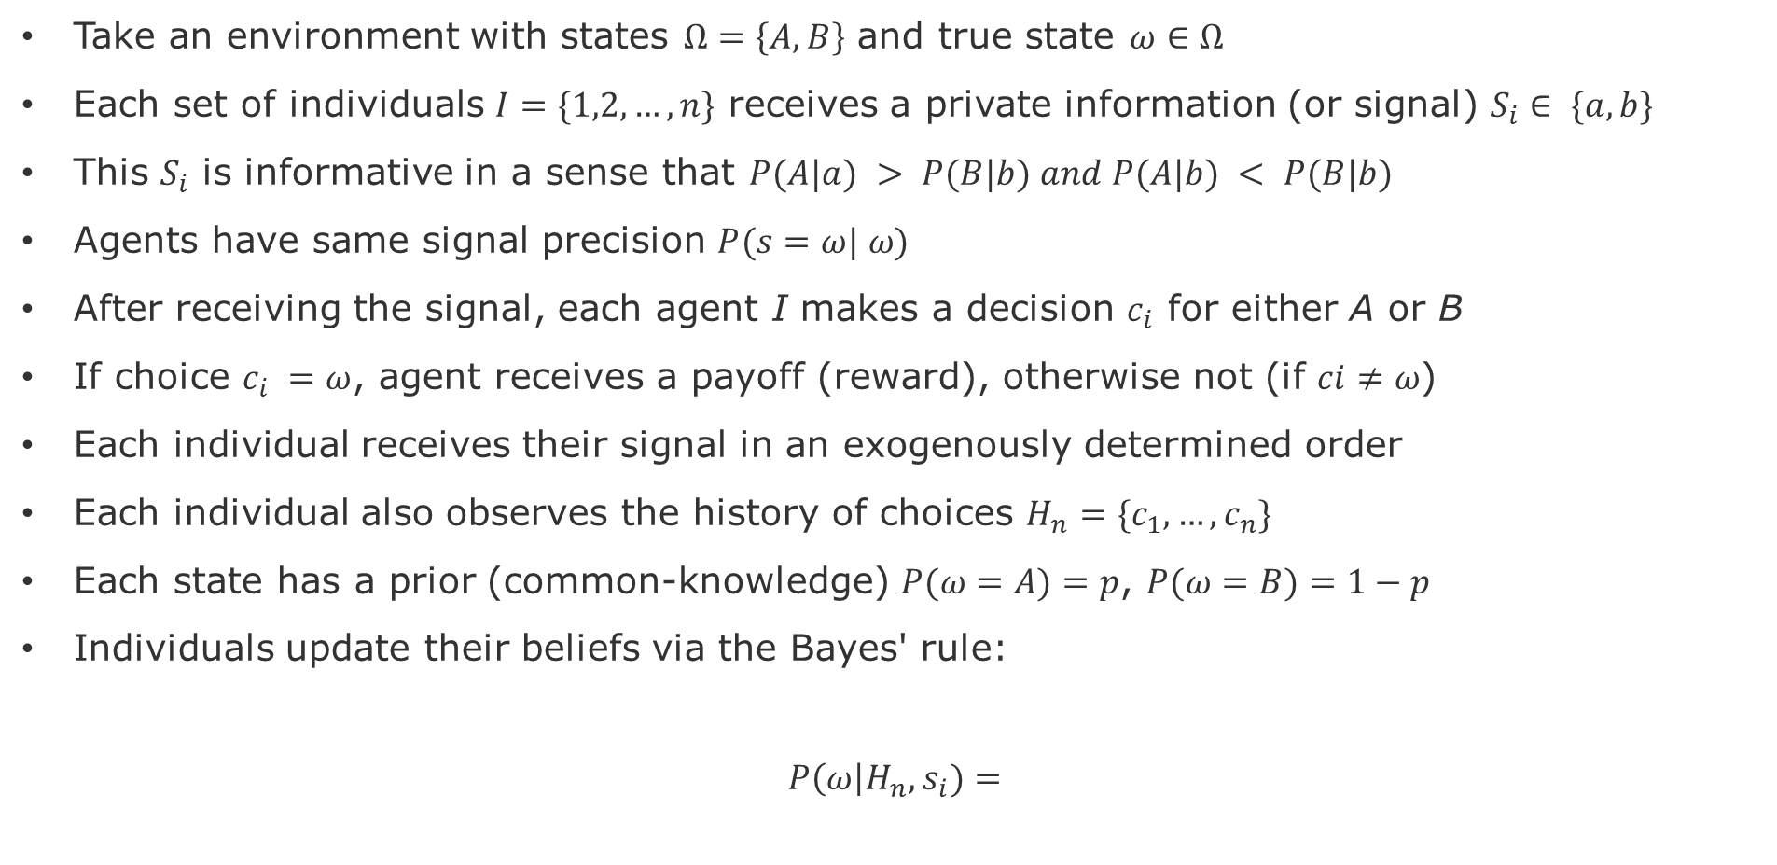
Formal definition of a Cascade
Take an environment with states $Ω=\left\{A,B\right\}$ and true state $ω∈Ω$
Each set of individuals $I=\{1,2,…,n\}$ receives a private information (or signal) $S_{i}∈ \{a,b\}$
This $S_{i}$ is informative in a sense that $P(A|a) > P(B|b) and P(A|b) < P(B|b)$
Agents have same signal precision $P(s=ω| ω)$
After receiving the signal, each agent I makes a decision $c_{i}$ for either A or B
If choice $c_{i} =ω$, agent receives a payoff (reward), otherwise not (if $ci≠ω$)
Each individual receives their signal in an exogenously determined order
Each individual also observes the history of choices $H_{n}=\{c_{1},…,c_{n}\}$
Each state has a prior (common-knowledge) $P(ω=A)=p$, $P(ω=B)=1−p$
Individuals update their beliefs via the Bayes' rule:
$$P\left(ω\right|H_{n}, s_{i})=$$
$$P\left(ω=A\right|, s_{i})=\frac{P\left(a \right|A)P(A)}{P\left(a \right|A)P\left(A\right)+P\left(a \right|B)P(B)}$$

Slide 7
Decision-Based Cascading Models

Slide 8
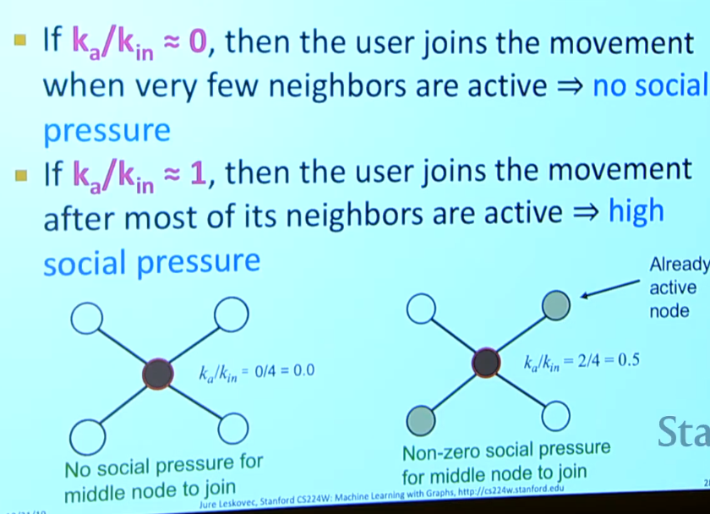
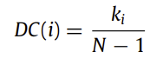
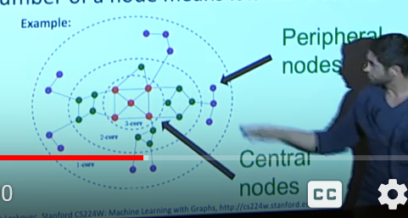
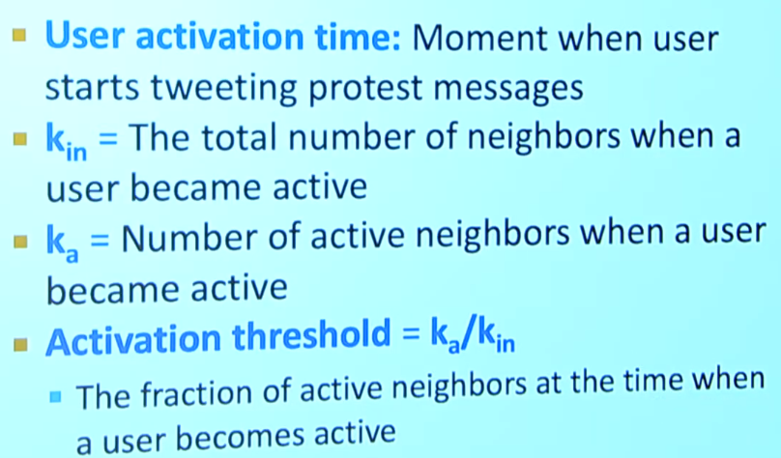
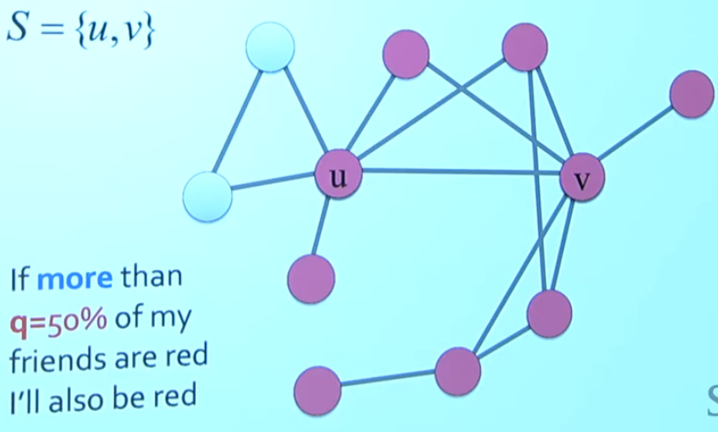
Cascades – Definitions
Notes:
Cascading process is Non-reversible process. Nodes made a decision because they believed that individually they would get benefit to join the cascade.

Slide 9
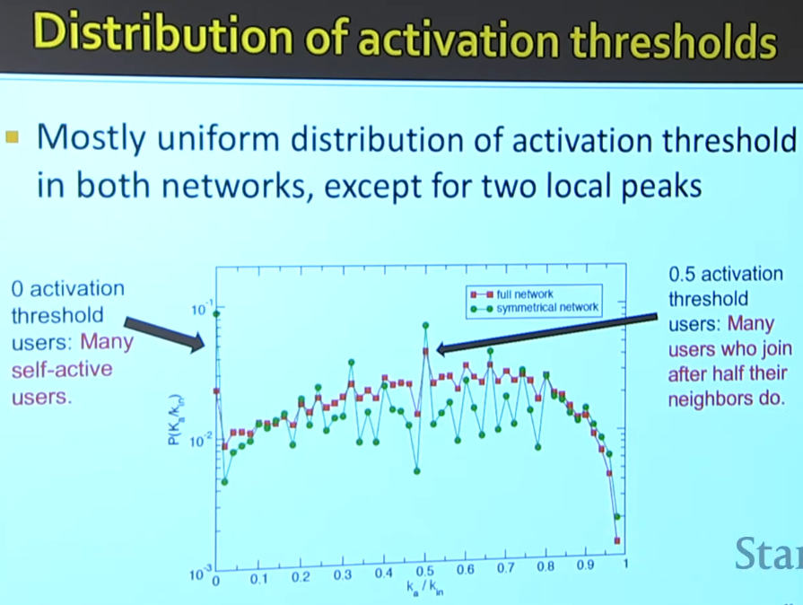
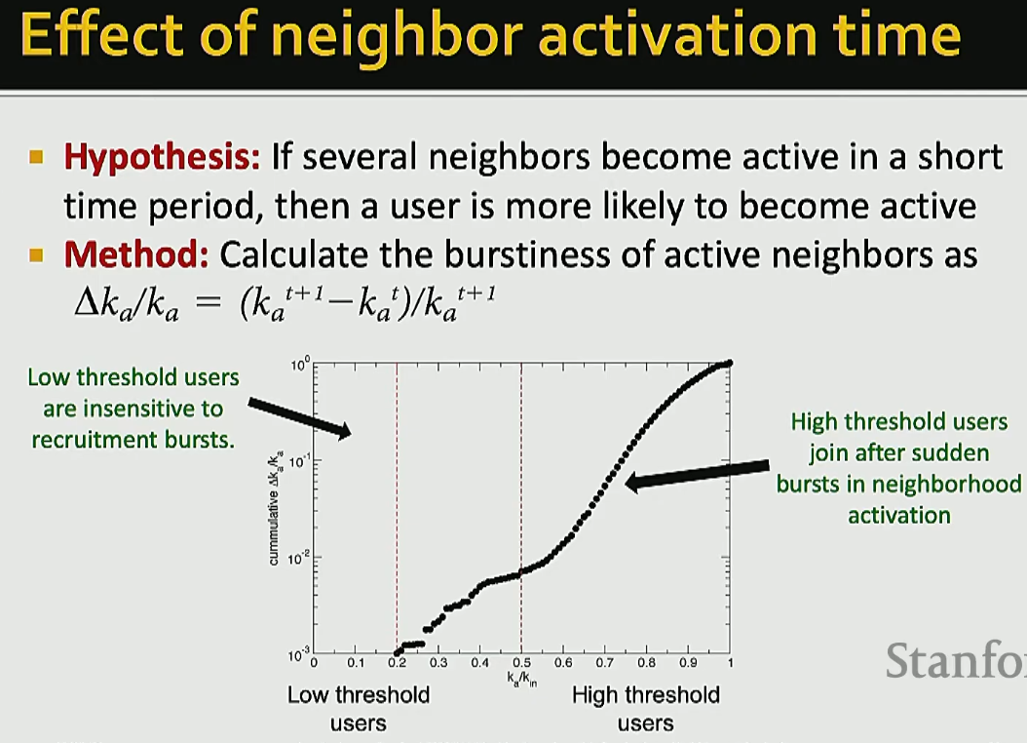
Descriptive
Different nets diff activation patterns

Slide 10
How to start (or prevent) a cascade?
Discover the superspreader nodes
Degree centrality:
k-core mehod: the bigests connected subgraph where each node has at least degree k
How do obtain it? Repeatedly remove all nodes with degree less than K.
The higher k-core, more central is the subgraph and corresponding nodes.
k-shell method:
Diversity (HIV study in South Africa)
2. Increase the incentives for event to spread (utility of products, trustworthiness of information, coupling between entities)
sources:
Notes:
The degree centrality (DC) [18] is the simplest index to measure nodes’ influence. The larger degree a node has, the

Slide 11
Propagation as Decision Making
Each person can adopt technology that maximizes its utility.
The benefit is based on how many of the neighbors adopted the same technology in t-1
For instance, if a node obtains a utility of “a” if the node adopts the technology A shared with a neighbor node.
Example: Technology adoption options are A, B, or AB. In the case of adopting AB, there is a cost “c”. Assuming that every node start with B, below is a possible intermediate state.
utility
-c
cost
-c
A
a
A
a
AB
max(a,b)
AB
b
B
How will the adoption of technology cascade through the network?
Will it cascade indefinitely, or will it stop at some point?
How do the individual costs of each pay-off affect the cascades?

Slide 12
Example
Path graph: start with B. and A is better than B, because a>b
What happens when one node switches to A?
With A, B, AB, Does A spread?
a=3
A
a=3
A
0
B
b=2
B
b=2
B
c=-1
-c
A
a=3
A
a=3
AB
b=2
AB
b=2
B
Hardwired to adopt A

Slide 13
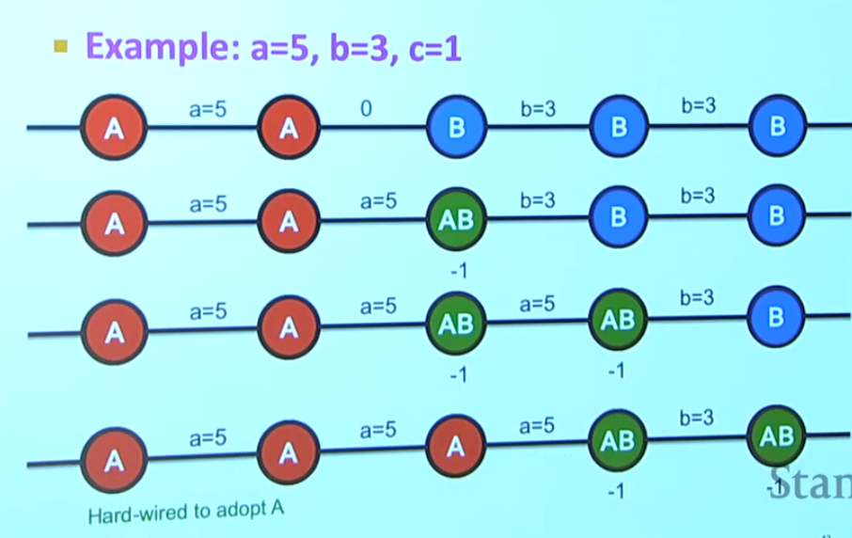
a=5
A
A=5
A
0
B
b=3
B
b=3
B
a=5
A
A=5
A
A=5
AB
b=3
B
b=3
B

Slide 14
Generalized Decision Model
Given payoffs: Fp(A) = a, Fp(B) =1, Fp(AB) = a+1-c
When X will choose A, B, AB?
A
X
B
B vs A
a=1, c>1 → AB ϵ[-∞,1], B=1, A=1
a=1, c<1 → AB ϵ[1,2], B=1, A=1
AB vs B
a=c<1 → AB=1, B=1, A<1
a=c>1 → AB=1, B=1, A>1
Cost c
A
B
A
c=1
AB vs A
c=1, a<1 → AB=A<1, B=1, A<1
c=1, a>1 → AB=A>1, B=1, A>1
B
AB
AB
a=1
Payoff a
a=c=1 → AB=B=A=1
sources: Lecture 12 Network Effects and Cascading Behavior, Stanford CS224W, Jures Leskovec
Notes:
] Eisenberg, Joseph. "R0

Slide 15
Generalized Decision Model
Given payoffs: Fp(A) = a, Fp(B) =2, Fp(AB) = a+1-c
When X will choose A, B, AB?
AB
X
B
B vs A
a=2, c>1 → AB ϵ[-∞,2], B=2, A=2
a=2, c<1 → AB ϵ[2,3], B=2, A=2
AB vs B
c=a-1,c<1 → AB=2, B=2, A ϵ [1,2]
c=a-1,c>1 → AB=2, B=2, A > 2
Cost c
A
B
A
c=1
AB vs A
c=1, a<2 → AB=A<2, B=2, A<2
c=1, a>2 → AB=A>2, B=2, A>2
B
AB
AB
1
2
Payoff a
a=2,c=1 → AB=B=A=2
sources: Lecture 12 Network Effects and Cascading Behavior, Stanford CS224W, Jures Leskovec
Notes:
] Eisenberg, Joseph. "R0

Slide 16
Bond, R. M., Fariss, C. J., Jones, J. J., Kramer, A. D., Marlow, C., Settle, J. E., & Fowler, J. H. (2012). A 61-million-person experiment in social influence and political mobilization. Nature, 489(7415), 295-298.
Bessi, A., & Ferrara, E. (2016). Social bots distort the 2016 US Presidential election online discussion. First Monday, 21(11-7).

Slide 17
Probabilistic Cascading Models

Slide 18
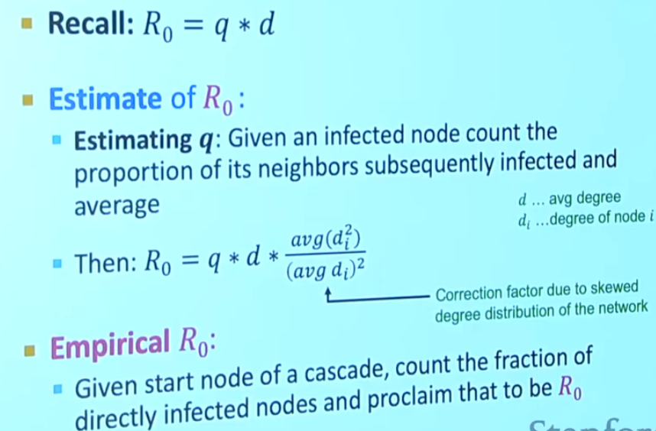
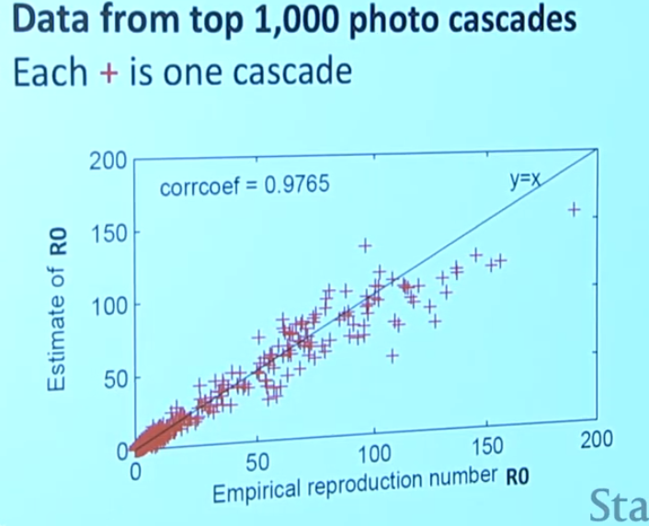
Notes:
Beginning already gives a good estimate of the Ro, but we also see where it does not work well, for the super popular,
Reproductive number is non-stationary, because as more people get infected it gets more difficult to find other infected ones.
So, it has a concave shape, fast growth, plateaus, then decays.

Slide 19
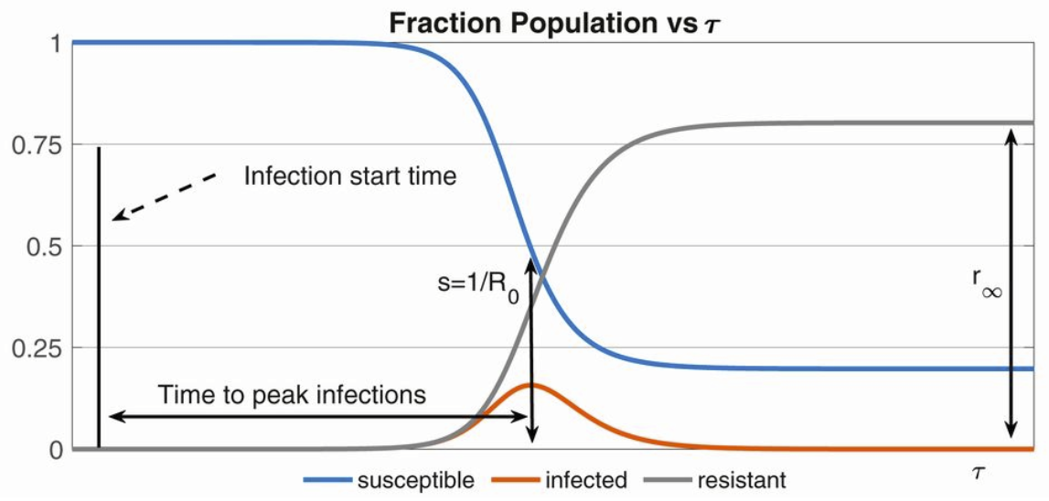
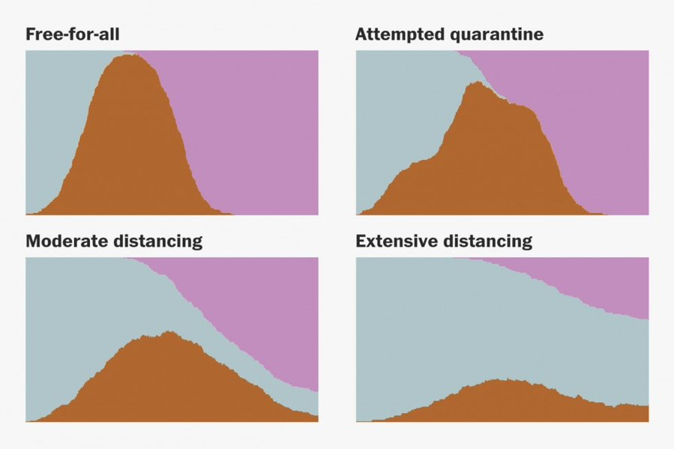
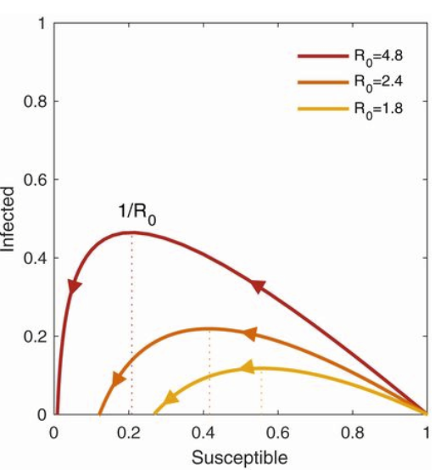
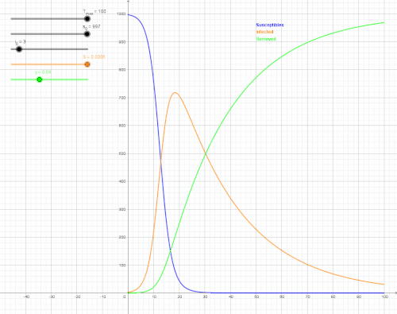
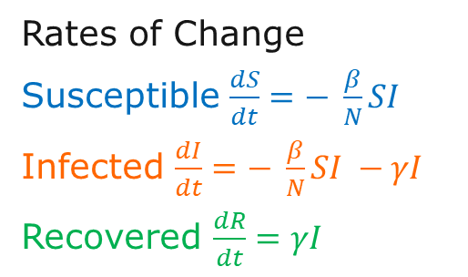
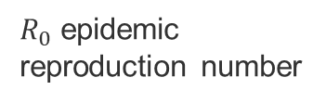
SIR model
α alpha
μ*
[Bertozzi 2020]
Susceptible
βI
Infected
γ
Recovered
μ
μ
μ
μ* birth rate
μ mortality rate
I infection rate
γ recovery rate
α reinfection rate
[Stevens 2020]: https://twitter.com/Harry_Stevens/status/1238940084994523136
S
I
R
$R_{0}$epidemic reproduction number
[Bertozzi 2020]
[Eisensberg 2020]
Rates of Change
Susceptible $\frac{dS}{dt}=− \frac{β}{N}SI$
Infected $\frac{dI}{dt}=− \frac{β}{N}SI −γI$
Recovered $\frac{dR}{dt}=γI$
[Wikipedia 2020]
Notes:
If alpha = zero, then we have lifelong immunity
[Wikipedia 2020] https://en.wikipedia.org/wiki/Compartmental_models_in_epidemiology#The_SIR_model
[Eisenberg 2020] Eisenberg, Joseph. "R0: How scientists quantify the intensity of an outbreak like coronavirus and its pandemic potential." The Conversation, Michigan University School of Public Health 27 (2020). https://sph.umich.edu/pursuit/2020posts/how-scientists-quantify-outbreaks.html
[Bertozzi 2020] Bertozzi, Andrea L., et al. "The challenges of modeling and forecasting the spread of COVID-19." Proceedings of the National Academy of Sciences 117.29 (2020): 16732-16738.
[Stevens 2020] Why outbreaks like coronavirus spread exponentially and how to "flatten the curve"
https://twitter.com/Harry_Stevens/status/1238940084994523136

Slide 20
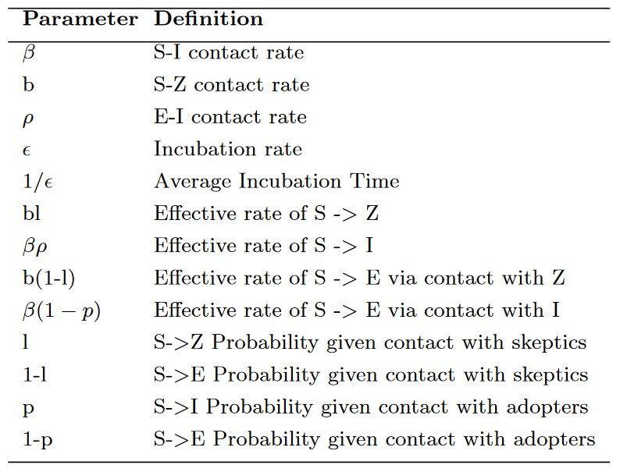
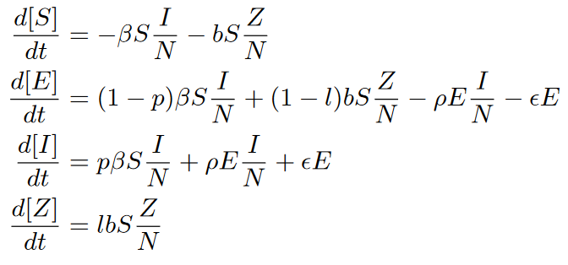
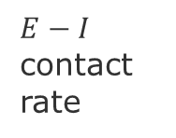
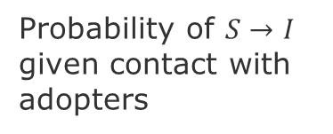
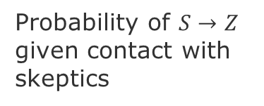
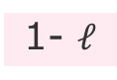
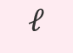
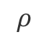
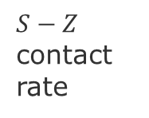
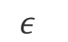
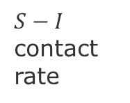
SEIZ model
S susceptible, E exposed, I infection rate, Z skeptics
Probability of $S→I$ given contact with adopters
α alpha
$S−I$ contact rate
Infected
p
$$ε$$
Susceptible
β
$$ρ$$
1-p
Exposed
$E−I$ contact rate
$S−Z$ contact rate
b
1- $ℓ$
Skeptic
N = population size
Probability of $S→Z$ given contact with skeptics
$$ℓ$$
Notes:
Jin, et al. 2013, Epidemiological Modeling of News and Rumors on Twitter
Vosoughi, S., Roy, D., & Aral, S. (2018). The spread of true and false news online. Science, 359(6380), 1146-1151.

Slide 21
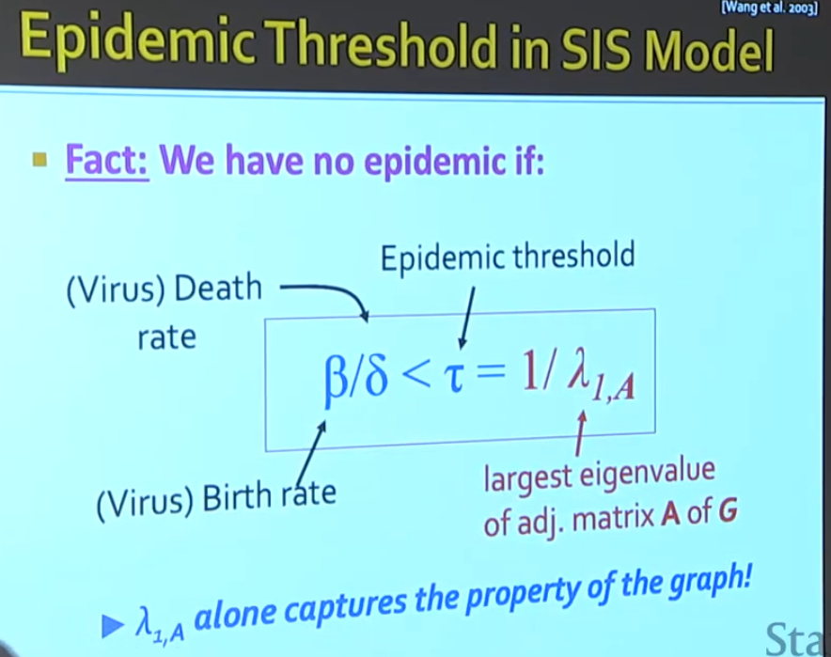
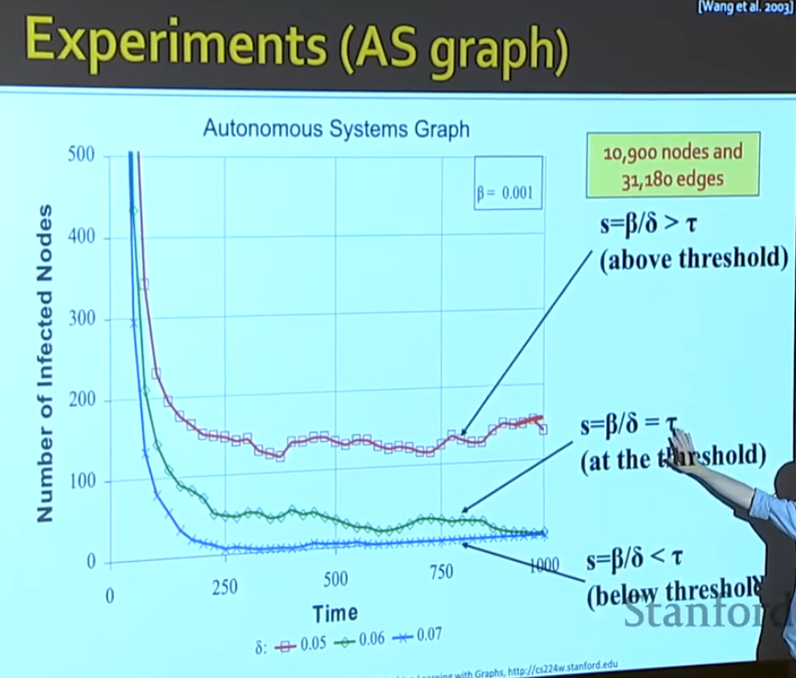
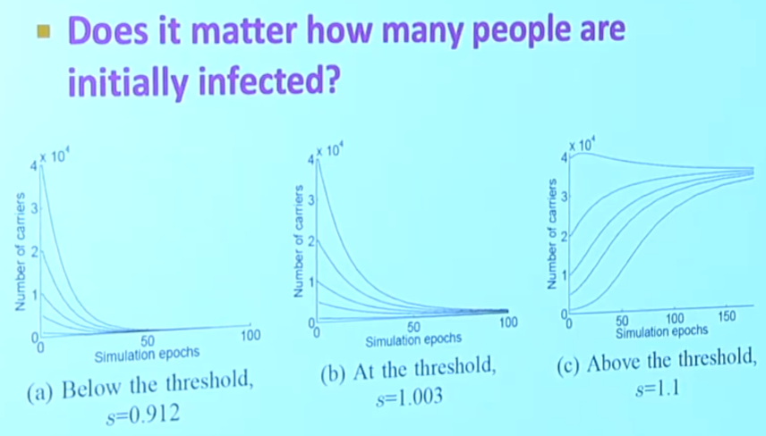
SIS model

Slide 22
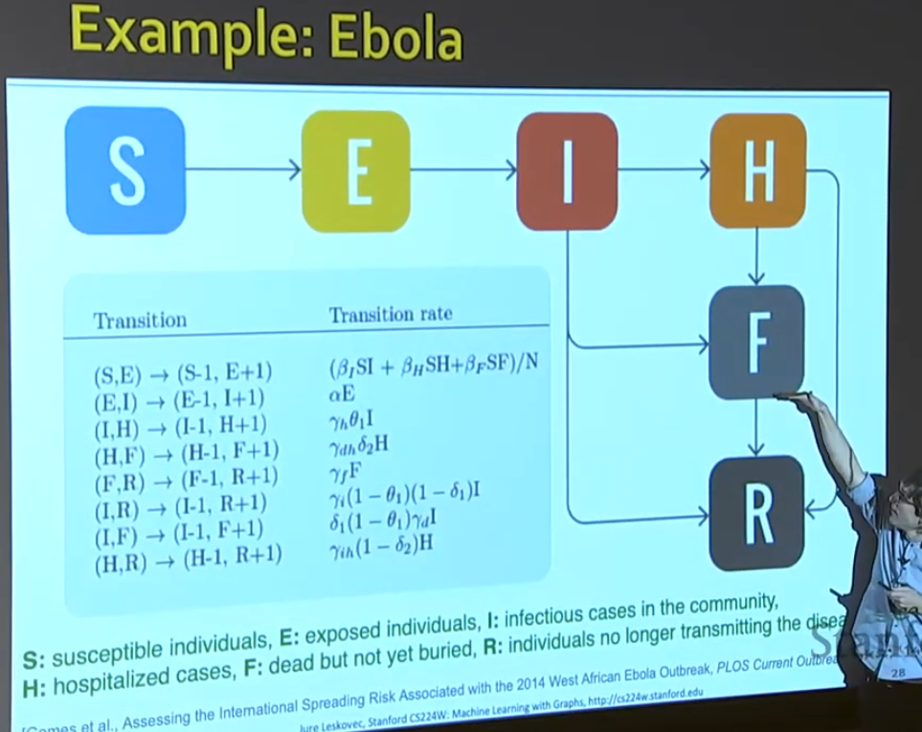
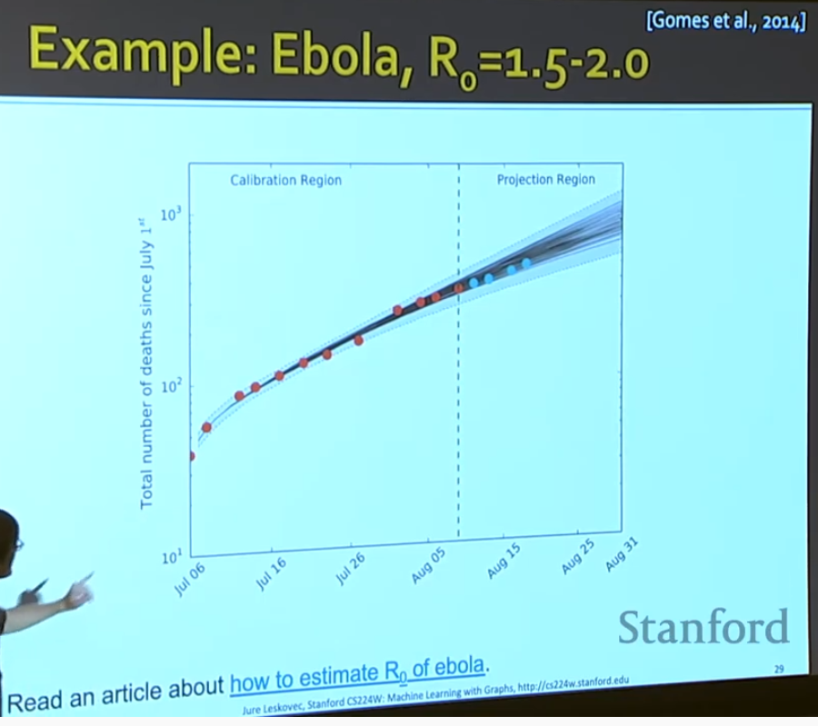

Slide 23
Independent Cascade model [Kempel, Kleinber, Tardos 2003]
D. Kempe, J. Kleinberg, and ´ E. Tardos, (2003) “Maximizing the spread of influence through a social network,” ACM SIGKDD

Slide 24
Greedy approach

Slide 25
Sketch approach

Slide 26
Failure Cascades in Power Grids
The topology of the network may not be the main factor in predicting failure cascades in power grids because these networks are affected by complex dynamical phenomena [Kinney-etal-2005][Newman 20
Metrics to measure network reliability/resilience to attacks [Pagani & Aiello 2013]:
Connectivity loss, Efficiency, Loss of load probability,
Influence on largest component size and path length,
Robustness through mean degree, motifs, and patch size analysis
Sensitivity
Flow availability
Line overload
Notes:
Pagani, G. A., & Aiello, M. (2013). The power grid as a complex network: a survey. Physica A: Statistical Mechanics and its Applications, 392(11), 2688-2700.
Kinney-etal-2005_Modeling cascading failures in the North American power grid
Newman, M. (2018). Networks. Oxford university press.

Slide 27
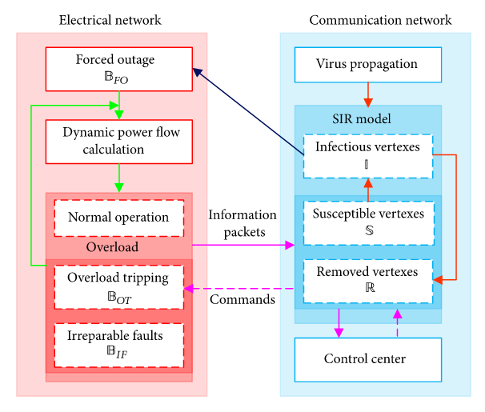
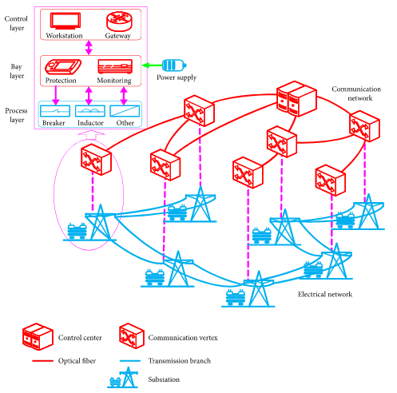
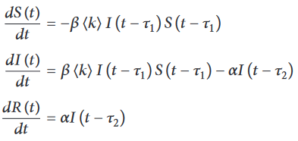
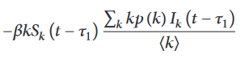
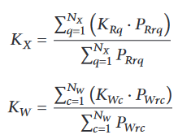
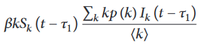
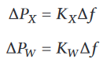
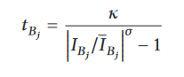
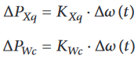
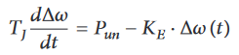
Cascade Failures in Electrical Communication Networks (ECN) [wang 2019]
interdependent fault propagation model
ECN= smart grid to monitor and control electrical networks
Virus infection propagates causing a failure cascades leading to energy blackouts.
SIR expressed in vertex degree
System frequency characteristics
Load Px and Generation Pw
Redistribute Power Unbalance
Dynamic Power Flow Algorithm
overloaded operational time at each branch Bj
source: Wang et al. (2019), Cascading Failures Analysis Considering Extreme Virus Propagation of Cyber-Physical Systems in Smart Grids
Notes:
Tau-1 infection cycle
Tau-2 removal cycle
Kx = Equivalent load frequency regulation
Kw = Equivalent generator unit power regulation
Delta Px = Changes in power of all loads
Delta Px = Changes in power of all generators
Delta Omega = Changes of angular acceleration of equivalent generator
Rotor equation allow to compute the
Delta Kxq = Changes of power of load q
Delta Kwc = Changes of power of generator c
Tj =Equivalent Inertia time constant
KE = system unit power regulation
Interactive Cascading Failure Model
Power flow redistribution employs
primary frequency regulation ‎[46, 47] and rotor equation ‎[48]
Two types of flow: communication and power
Two Time windows:
- virus infection cycle (SIR)
tripping time of overloaded branches
[Wang

Slide 28
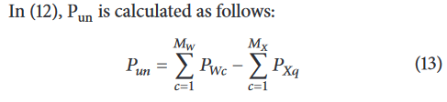
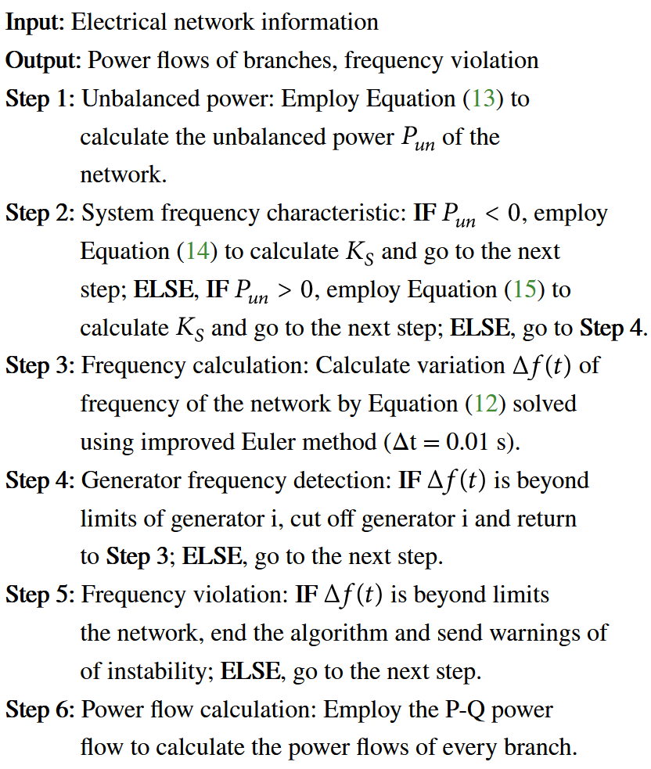





Dynamic Power Flow Algorithm
source: Wang et al. (2019)
Notes:
Wang et al. (2019), Cascading Failures Analysis Considering Extreme Virus Propagation of Cyber-Physical Systems in Smart Grids

Slide 29
Influence Maximization Models

Slide 30

Robustness to Time Delays
Notes:
source: Steve Brunton, Control Theory and COVID-19: Models
https://www.youtube.com/watch?v=jmfsSmHAQ2o

Slide 31
My reading wish-list on Influence maximization
Notes:
David Kempe, Jon Kleinberg, and Éva Tardos. 2003. Maximizing the spread of influence through a social network. In Proceedings of the ninth ACM SIGKDD international conference on Knowledge discovery and data mining (KDD '03)

Slide 32
Outbreak Detection Models

Slide 33
Final Presentations of GNN projects
05/Mar: Name Entity Disambiguation - Valdimar & Mai
17/Mar: Comment Predictions on Online News – Sassan
19/Mar: Protein Interactions – Henrik & Simon
24/Mar: Space-Time Graphs for Traffic Predictions – Max, Tiago & Tibor
26/Mar: Community Interaction Predictions – Bastian, Berkey & Leo
29/Mar: Key-phrase Classification - Maria
Last day to turn in the report March 29.

Slide 34
END

